Slide 1
Governor’s Appointments
How to be Appointed to a State Board or Commission

Slide 2
Governor Gavin Newsom’s “California Dream”
“The California Dream-the idea that every person can achieve a better life, regardless of where they start out- is central to who we are as Californians…we can and must reanimate the California Dream, building a California for All.”
To achieve this Dream, we need civic minded individuals to be part of the governing process.
First, identify your own interests, something that you have a passion for, or maybe have had a job doing, or gone to school to do, that would make you a good resource on the various Boards and Commissions.
Second, research the different Boards and Commissions that you are interested in, making sure to look at the time commitment, travel, and pay if applicable. Once you have decided, (you can apply for up to 10 positions using one application), now is the time to apply.

Slide 3
What is a Governor’s Appointment?
There are 295 Boards and Commissions, with over 3,000 appointments, that are full-time salaried, full-time salaried on Boards and Commissions, part-time salaried and positions that require Senate Confirmation.
There is a wide range of topics, from agriculture, beauty schools, water requirements, to forestry, and cultural areas etc., that are covered by California state law, working with state agencies, that oversee the implementation and adherence to the law.
Diversity of civic minded people, different generations, cultures, and experiences are welcome to apply, and are needed to make the “California Dream” possible.

Slide 4
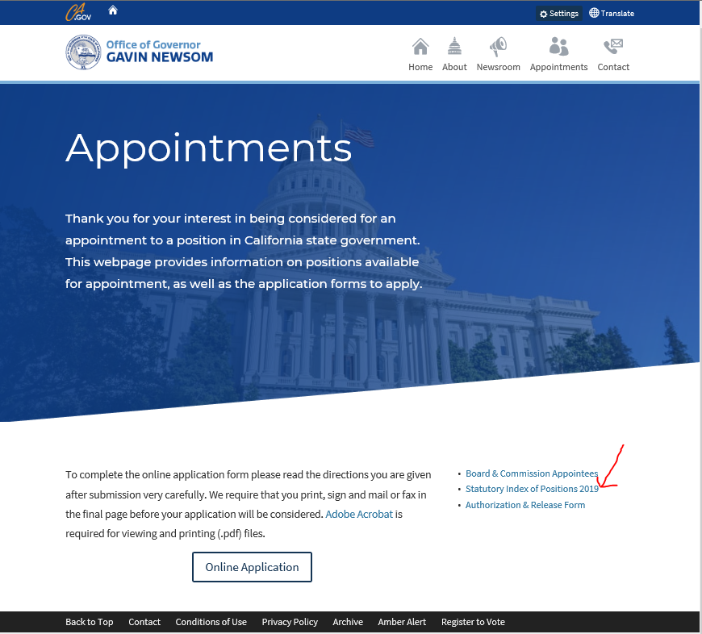
Identify the Boards or Commissions
Go to www.gov.ca.gov/appointments to see what Boards or Commissions there are, on the far right hand side, “click” on the “Statutory Index of Positions 2019”
This is a complete alphabetical listing of all positions with footnotes indicating whether the position is full-time salaried, full-time salaried with Boards and Commissions, part-time salaried with Board and Commissions and those that require Senate Confirmation.
Decide which of the Boards or Commissions best fit with your personal, educational and work experiences, your expertise and/or interests.
The next step is to research the Boards or Commissions.

Slide 5
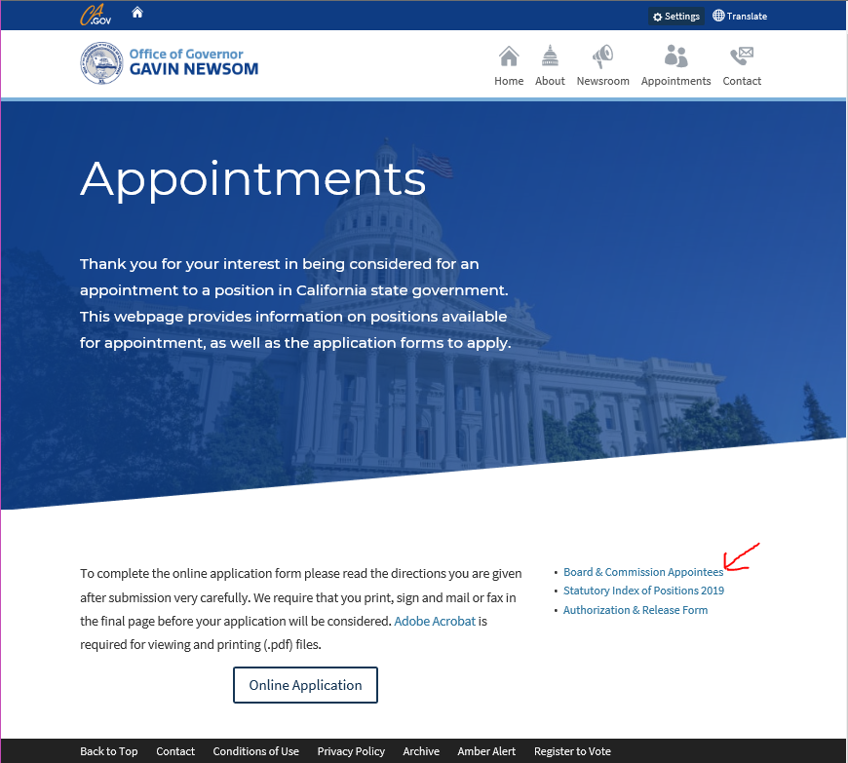
Research the Boards or Commissions
Go to the Governor’s website, www.gov.ca.gov/appoinments and on the far right hand side, “click” on “Board & Commission Appointees”. The “List of Appointments” page will show up, with a sub header titled “Governor’s Appointment Index”, which also includes Other Appointing Authorities Index.
There will be alphabetized boxes that have the Boards or Commissions listed. “Click” on the boxes in which you are interested. There will be information on the purpose of the Board or Commission, the number of positions, the term of the positions, the duties of the Board or Commission, the laws that govern the Board or Commission, etc. There will also be a Registry, of the persons who currently are on the Boards or Commissions, when they were appointed as well as their end date of appointment or whether their appointment is indefinite or “at the pleasure” of the Governor.
Once you have decided which Board(s) or Commission(s) meet your qualifications and you want to be part of the governing process, the next step is to apply.
The following is an example of the information that is provided for each of the different Boards and Commissions.

Slide 6
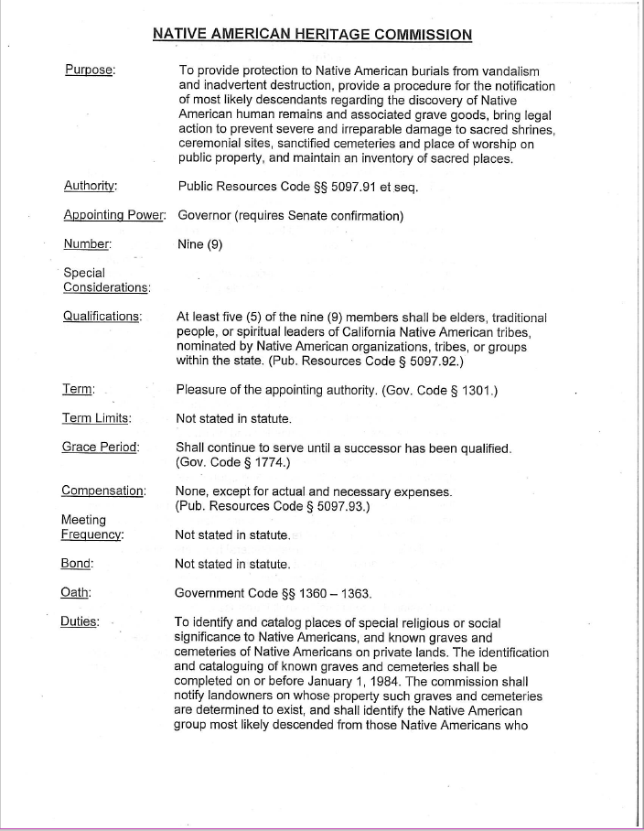
Example

Slide 7
Example (cont’d)

Slide 8
Example (cont’d)

Slide 9
How to Apply for the Boards and Commissions
There is an on-line application process. The application is extensive and may be time consuming, so gather your information before you start to fill out the application.
Go to www.gov.ca.gov/appointments/ and “click” on the “Online Application”
If you do not complete the application in one session, you may save it and complete the application at another time. Be sure to read and follow the instructions on saving your application. Do not “Submit” your application until you are completely finished.
Now “click” on “Begin Application”. Once you are completely finished, click on “Submit”
Another screen will come up that will congratulate you for applying and completing the application process and you will get a copy of all the information that you have completed. However, there is another step to be completed.

Slide 10
How to Apply for the Boards and Commissions (cont’d)
There will also be a “Certification, Authorization and Release Form” that must be completed, printed, and signed. Due to the confidentiality of the information provided, please fax the form to the Governor’s Office at (916) 558-3190.
You may also mail the “Certification, Authorization and Release Form” and a copy of your resume to: Attn: Governor’s Office-Appointments Unit, State Capitol, Suite 1173, Sacramento, CA 95814.
Be sure to keep copies of all documents for your records.
As positions on the various Boards and Commissions become available, be sure that your information is up to date and on the Governor’s database for consideration.

Slide 11
Frequently Asked Questions
Does a position have to be available for me to apply? No, you can submit your application and it will be considered once there is an opening.
Will my application be kept on file until an opening occurs on the Board or Commission that I have applied? Yes, once your application is in the database, but, it is still your responsibility to make sure that your application is up to date.
Does the “Certification, Authorization and Release Form” allow for research into all the information that I have put on my application? Yes.
Do I have to have a college degree, own my own business, have farming skills etc., to qualify for a position on a Board or Commission? No, depending upon the qualifications that are listed for each Board or Commission.
What happens now that I have applied? Once your application is reviewed, and an opening occurs on that Board or Commission, you will be contacted for an interview.
If you have any questions, please contact the California Tribal Advisor Office at (916) 319-9219 for more information.

